Slide 1
APPRECIATIVE INQUIRY IN PRACTICE: IMAGINING A BRIGHT FUTURE
Drs. Gary Mangiofico and Julie Chesley
And Colleagues
Pepperdine University
Graziadio School of Business & Management

Slide 2
Workshop Agenda
Learn about the theory and practice of Appreciative Inquiry (AI).
Experience an Appreciative Inquiry (AI) process.
Design a process for using AI in your organization.

Slide 3

“No problem can be solved from the same consciousness that created it. We must learn to see the world anew.”
Einstein

Slide 4

What is Appreciative Inquiry?
AI is a philosophy and practical method to search for the best in people, their organizations and the world around them. It involves systematic discovery of what gives life to an organization or a community when it is most effective and most capable.
David Cooperrider

Slide 5
Useful Assumptions
Seeds of organizational change are implicit in the first questions we ask.
In every system, something is working
Most important resource for generating constructive organizational change is our cooperative imagination & mind. AI reclaims our imaginative competence.

Slide 6

Ap-pre’ci-ate, v.,
    1.valuing; the act of recognizing the best in people or the world around us; affirming past and present strengths, successes, and potentials; to perceive those things that give life (health, vitality, excellence) to living systems
    2. to increase in value, e.g. the painting has appreciated in value.
      Synonyms: VALUING, PRIZING, ESTEEMING, and HONORING.

Slide 7

In-quire’ (kwir), v.,
    1. the act of exploration and discovery.
    2. To ask questions; to be open to seeing new potentials and possibilities.
      Synonyms: DISCOVERY, SEARCH, and SYSTEMATIC EXPLORATION, STUDY.

Slide 8
WHY
APPRECIATIVE
INQUIRY?

Slide 9
Processes for Organization Change
Deficit Based
“Traditional”
Strengths Based
“AI”
Appreciating
“Valuing the Best of what is”
Identification of Problems
Organizations are problems
to be solved
Envisioning
“What might be”
Organizations are possibilities
to be embraced
Analysis of Causes
Analysis of Possible
Solutions
Dialoguing
“What should be”
Innovating
“What will be”
Action Planning
“Treatment”

Slide 10

Deficit Focus: Consequences
Fragmentation / Culture of blame
Cynicism
Fatigue
Reliance on experts to “fix” the problem
Slow: puts attention on yesterday’s causes

Slide 11
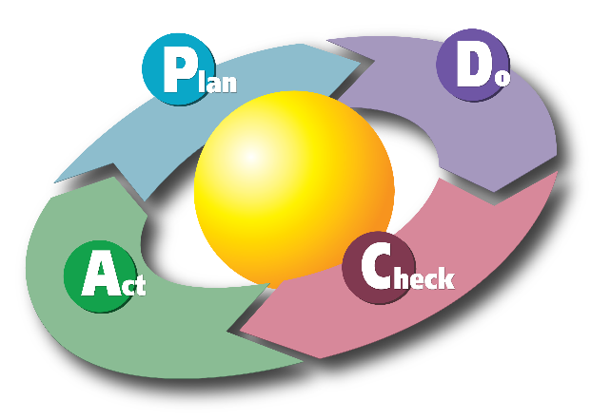
Typical Problem Solving Cycle
Develop action plan to close the gap

Slide 12
AI Focus
When you’re at your best, what would
that look like?

Slide 13

AI Focus
When you’re at your best, what
would that look like?
Action plan to close this gap!

Slide 14

If we carry parts of the past into the future, they should be what is best about the past

Slide 15
DEFINE: Choose The Positive as the Focus of Inquiry
Healthy organizations begin the process of change by inquiring about and building upon the positive aspects of its people and their experience. Building on the positive leads the organization to focus on what it does well and to create an image of a future based on its own best practices and highest values.

Slide 16
The Art of the Question
Focus on Problems or Possibilities?
Why do we have such low morale?
Why do I have to be on such a dysfunctional team?
Why do we have such high turnover?
Why are there so many complaints?
When have we been the most motivated and engaged?
When have we worked together the best as a team?
What conditions create a magnetic work environment?
When have we successfully had outstanding support and enthusiasm?

Slide 17
DISCOVER: Uncover Meaning & Purpose Through Story Telling
Appreciative Inquiry begins with a conversation (called an appreciative interview) in which people share stories about those things within the organization that they value – things they want to expand and extend in the future. Through the interviews, people identify the themes that connect with their most deeply held beliefs and values.

Slide 18
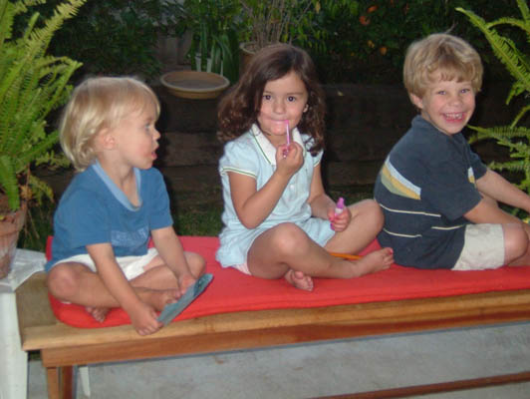
Inquire into stories about what gives life (DISCOVER)
Get into pairs with someone you don’t know
Read page 9 in your workbook, and interview each other using questions on page 10 for 40 min. Go through 1 interview at a time. Take your time.
  20 min A B
  20 min B A
Take your time and look for richness and detail in the stories
Jot down what excites or interests you…Stay curious
Asking the First Question
Begins the Intervention

Slide 19

Discovery (Continued)
Get in groups of 3 pairs (2+2+2=6) and sit at a table
Self Management Roles
  Discussion Leader
  Timekeeper
  Recorder
  Reporter
Use a flip chart pad and markers

Slide 20
Locate themes that appear in the stories (DISCOVER)
Introduce your partners vis-à-vis your interviews—share highlights, insights
Summarize themes on Flip Chart Paper
PLUS: choose one “high point” story from your group for someone to re-tell
See page 12 in workbook

Slide 21
Dot Voting
Use 3 Sticky Dots
You can put 1 dot on each topic
You are voting for the themes that resonate most with you in creating exceptional teams

Slide 22
DREAM: Create Shared Images of a Preferred Future
Building on the themes people create both a visual image and a written statement (possibility statement) describing how the organization would look and feel at its best. These shared images act as a guide for creating the organization’s preferred future.

Slide 23

Dream Phase: Image
Mind searches beyond discovery “naturally”
Creating positive and bold image of desired future
Go beyond what we “think” is possible

Slide 24
Dream Phase: Possibility Statements
Fundamental belief of how we want to pursue our dream
Essentially translating the image into a written format
  Right brain to left brain
Articulates the dream in a way we can work to design

Slide 25
Possibility Statements
Exciting
Provocative – they stretch and challenge
A realistic stretch
Desired (they represent our highest hopes)
Positive
Are written in the present tense, as if they are already happening

Slide 26
Example Possibility Statements
Organizational Learning Capacity
We find ways to say "yes" to creative ideas. No idea is a bad idea. Achievements are rewarded on group levels by peer selection and level of contribution. The future motivates our innovative visions as we flex the muscle of sharing best practices. Our action-oriented vision sets the course to continuously learn and improve from the ideas of our employees through positive reward by empowerment.
Easy Access to All
The doors of government are open to all citizens of the state. We welcome citizen visits to our offices and provide easy access to information about programs and services, face to face as well as online and on the phone

Slide 27
Create shared images & possibility statements (DREAM)
Step 1: Select 1 or more themes that resonate with your team about exceptional teamwork and discuss what those themes mean to each of you
Step 2: Collectively develop a creative image when these themes are fully present and at their best
Step 3: Once finished, on another piece of flip chart paper create a possibility statement
See pages 14-15 of workbook

Slide 28
DESIGN: Innovate Ways to Create That Preferred Future
Organizations identify specific action steps to take individually or in groups. These action steps are specific, concrete, and do-able, designed to move the organization toward its preferred future. The steps may be small and incremental, building on each other, or link to larger, more encompassing actions.

Slide 29
What do we mean by “Design” ?
Both a product and a process
As a verb…”to design”…Is to invent, to innovate, to conceive and to make choices
As a noun, “the organization design” …Is the set of choices we have made about the above.
BASIC QUESTIONS TO ANSWER:
--WHAT?
--WHO?
--HOW?
“Designing renders visible our hopes and dreams, it is the first signal of human intentions.”
--William McDonough

Slide 30
Elements of Organization Architecture
Education and training
Leadership style and culture
Staff/ people / relationships
Work processes and job design
Career structure and incentives
Organization structures
Stakeholder relationships
Communications
Systems
Reward and recognition practices
Decision making procedures
Beliefs about people

Slide 31
Think about the shared images of the exceptional teams and your possibility statements. Share in your teams what is the one commitment you will make to bring this image to life for the rest of our time together?

